Slide 1


Network-Attached Storage
CS-3103 : Operating Systems : Sec-A (NB) :
Disk Management…..
Network-attached storage (NAS) is storage made available over a network rather than over a local connection (such as a bus)
  Remotely attaching to file systems
NFS and CIFS are common protocols
Implemented via remote procedure calls (RPCs) between host and storage over typically TCP or UDP on IP network
iSCSI protocol uses IP network to carry the SCSI protocol
  Remotely attaching to devices (blocks)

Slide 2
Disk Scheduling
The problem of unbounded queue is solved by introducing scheduling of I/O requests made on the hard disk.
Each request is examined and, based on the current position of the R/W head of the hard disk, a decision is made as to when the data demanded by the requesting process should be served.
Operating Systems

Slide 3
Disk Scheduling Algorithms
Disk performance has two parameters:
  Access time: Seek time + Rotational latency + Data transfer time
  Disk bandwidth: It is the data transfer capacity of the disk to and from main memory. Disk bandwidth = Data in bytes transferred/Total time taken
Operating Systems

Slide 4


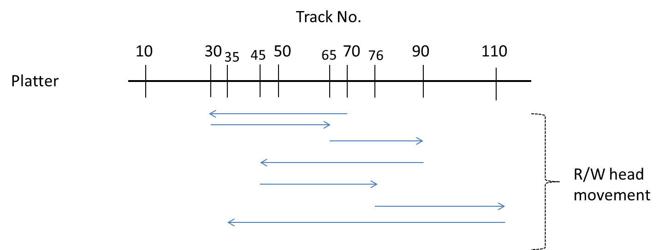
First Come First Served (FCFS)
The I/O requests are served in the order of their arrival.
Example: Let the disk I/O request arrive in the sequence no. of tracks 30 65 90 45 76 110 35. The R/W arm movement as per the FCFS policy is:

Slide 5
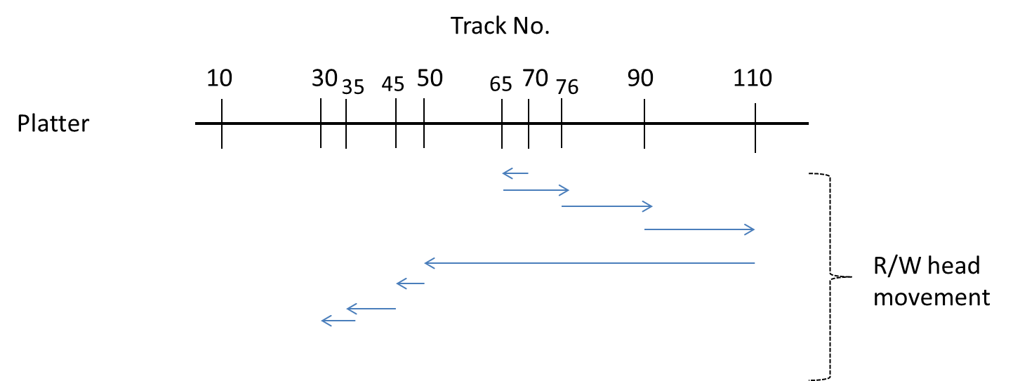
Shortest Seek Time First (SSTF)
In this strategy, the next I/O operation whose sector is closest to the current position of the R/W head is selected.
Example: Let the disk I/O request arrive in the sequence no. of tracks 30 65 90 45 76 110 35.
R/W movement in SSTF

Slide 6
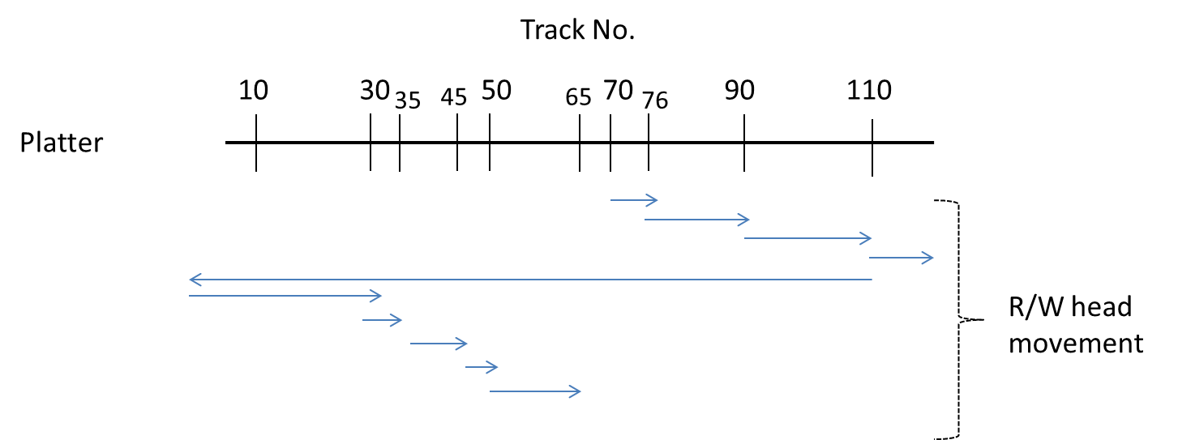
Circular SCAN (C-SCAN) Algorithm
The head moves from one end of the disk to the other, servicing pending I/O requests during the onward scan. After reaching the other end, the head immediately returns to the beginning of the disk. It does not serve the pending requests during the reverse scan.
R/W movement in C-SCAN

Slide 7

FCFS
Illustration shows total head movement of 640 cylinders

Slide 8
SCAN
The disk arm starts at one end of the disk, and moves toward the other end, servicing requests until it gets to the other end of the disk, where the head movement is reversed and servicing continues.
SCAN algorithm Sometimes called the elevator algorithm
Illustration shows total head movement of 208 cylinders
But note that if requests are uniformly dense, largest density at other end of disk and those wait the longest

Slide 9

SCAN (Cont.)

Slide 10
C-SCAN
Provides a more uniform wait time than SCAN
The head moves from one end of the disk to the other, servicing requests as it goes
  When it reaches the other end, however, it immediately returns to the beginning of the disk, without servicing any requests on the return trip
Treats the cylinders as a circular list that wraps around from the last cylinder to the first one
Total number of cylinders?

Slide 11

C-SCAN (Cont.)

Slide 12
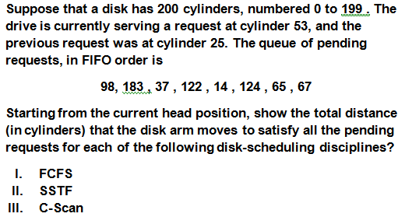
Exercises

Slide 13
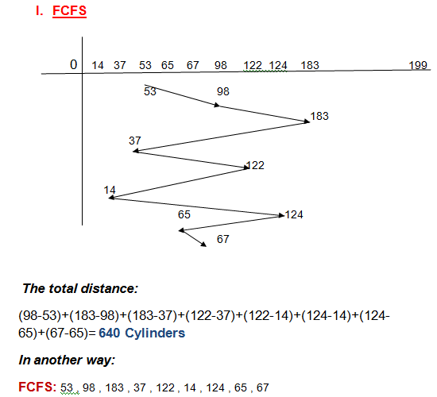
Answers

Slide 14
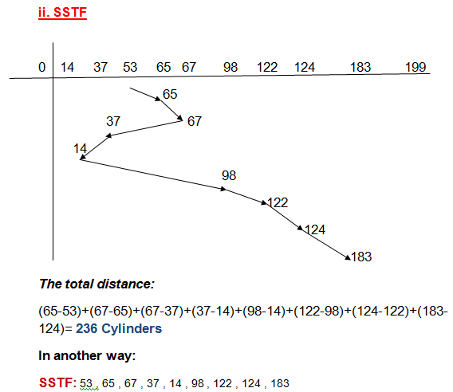
Answers

Slide 15
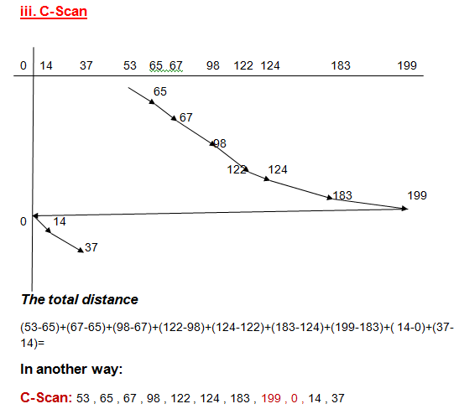
Answers

